Slide 1
Unit5

Slide 2
Viewing & Clipping
The primary use of clipping in computer graphics is to remove objects, lines, or line segments that are outside the viewing pane.

Slide 3
Any procedure that identifies those portions of a picture that are either inside or outside of a specified region of a space is referred to as a clipping algorithm or simply clipping.
The region against which an object is to clipped is called a clip window

Slide 4
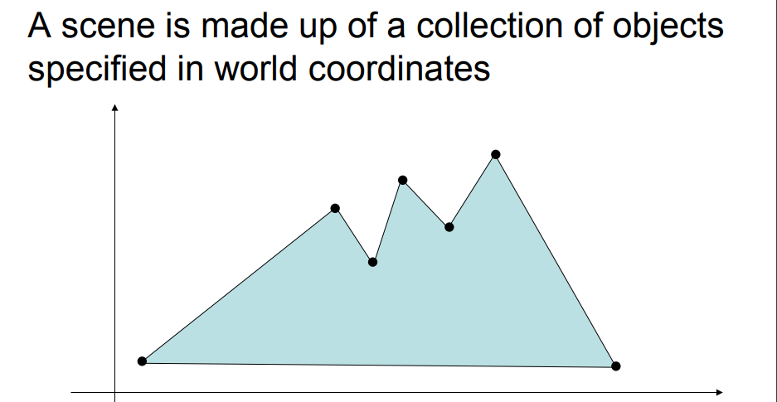

Slide 5
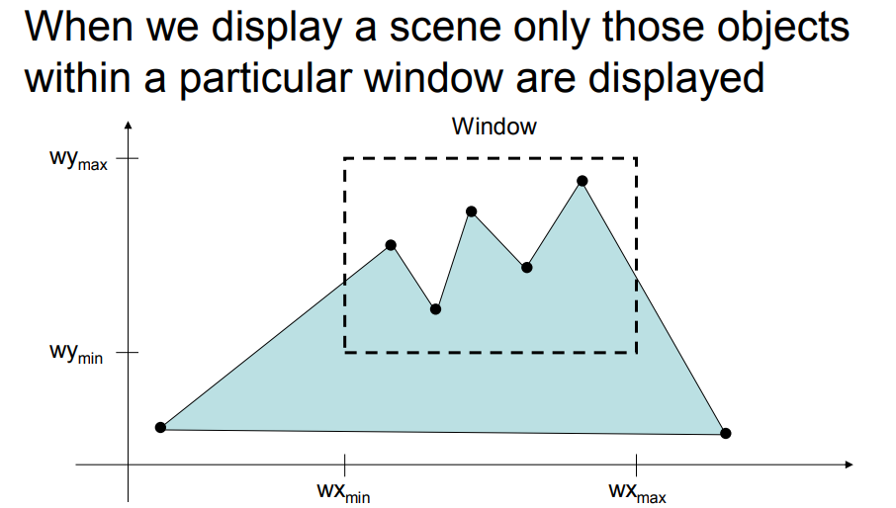

Slide 6
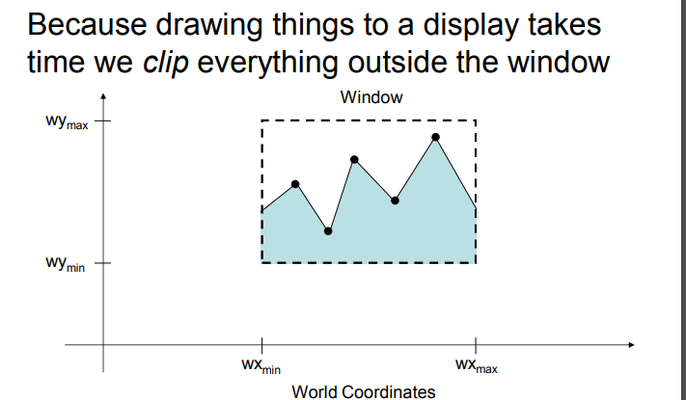

Slide 7
Window and viewport

Slide 8
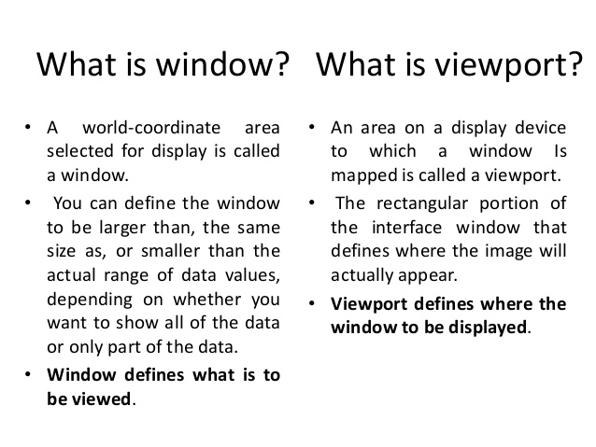

Slide 9
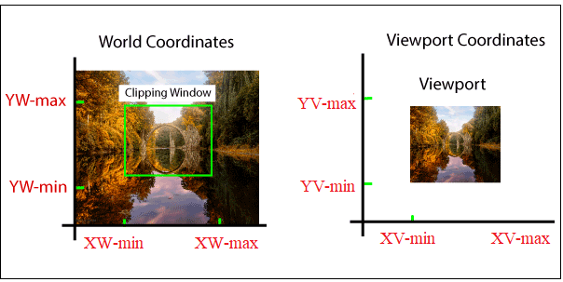

Slide 10
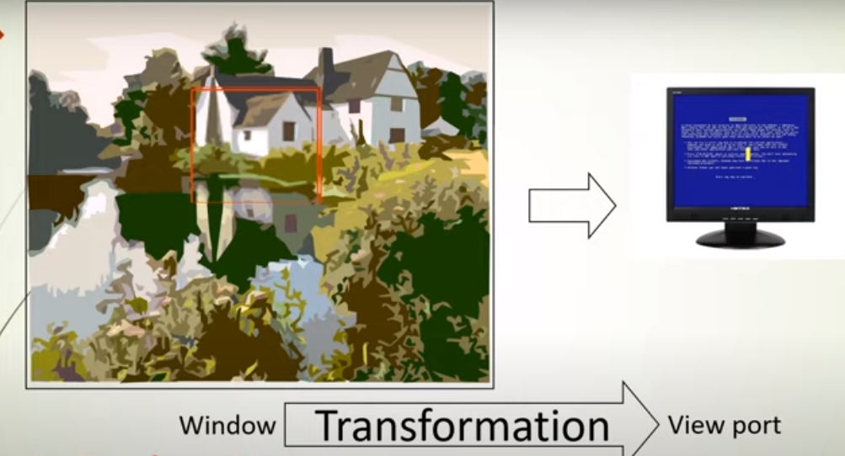

Slide 11
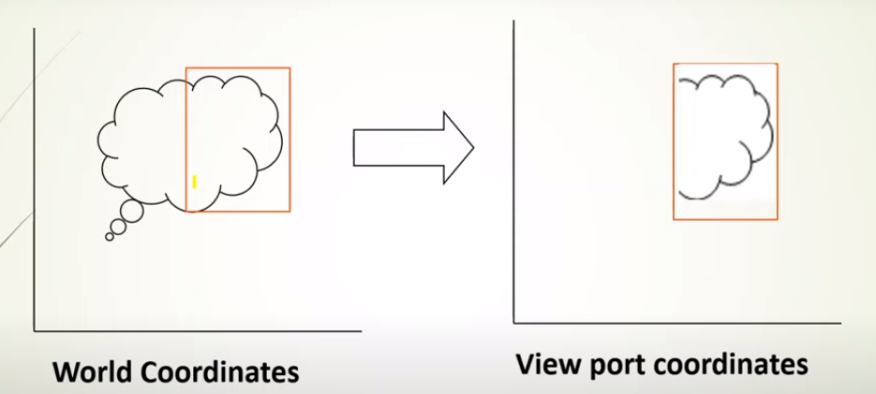

Slide 12
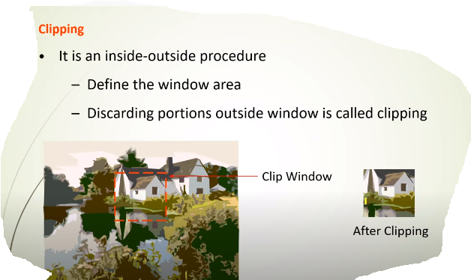

Slide 13
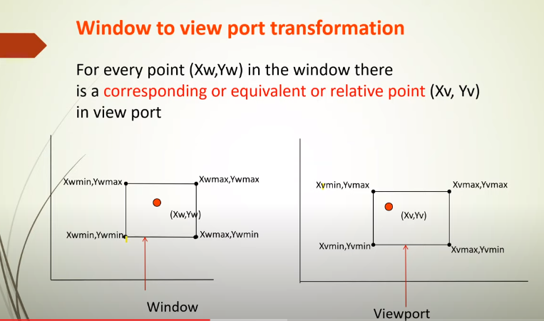

Slide 14
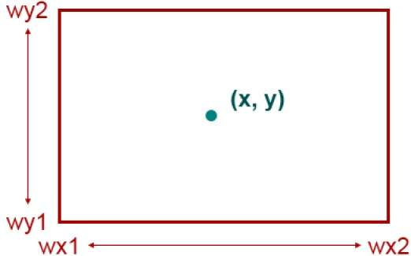
Point Clipping
Clipping a point from a given window is very easy. Consider the following figure, where the rectangle indicates the window. Point clipping tells us whether the given point X,Y is within the given window or not; and decides whether we will use the minimum and maximum coordinates of the window.
The X-coordinate of the given point is inside the window, if X lies in between Wx1 ≤ X ≤ Wx2. Same way, Y coordinate of the given point is inside the window, if Y lies in between Wy1 ≤ Y ≤ Wy2.

Slide 15
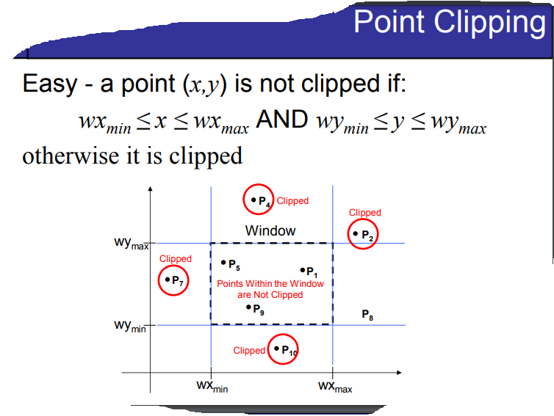

Slide 16
Line Clipping
The concept of line clipping is same as point clipping. In line clipping, we will cut the portion of line which is outside of window and keep only the portion that is inside the window.

Slide 17
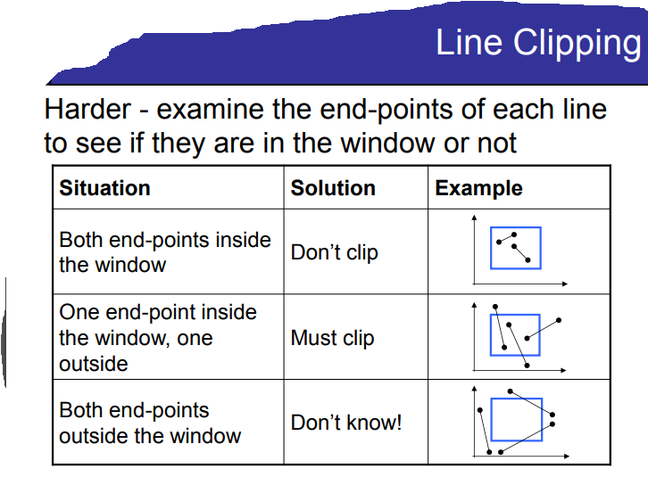

Slide 18
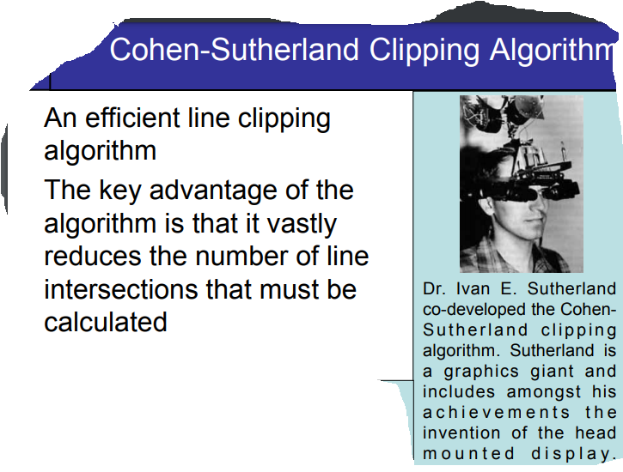

Slide 19
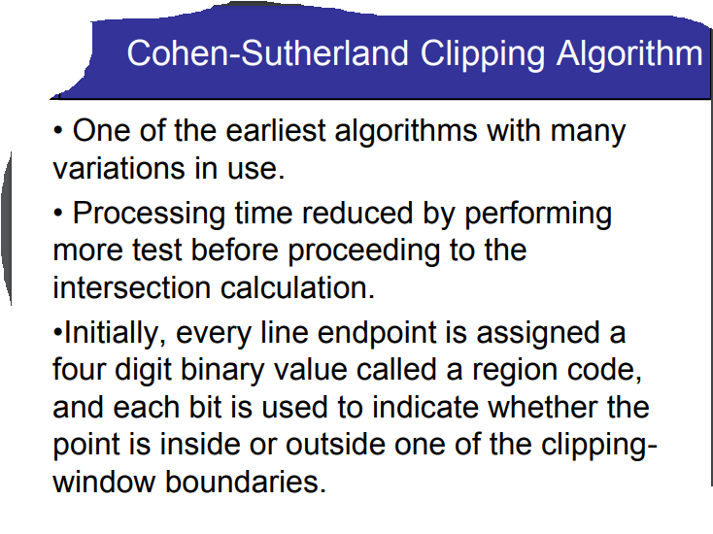

Slide 20
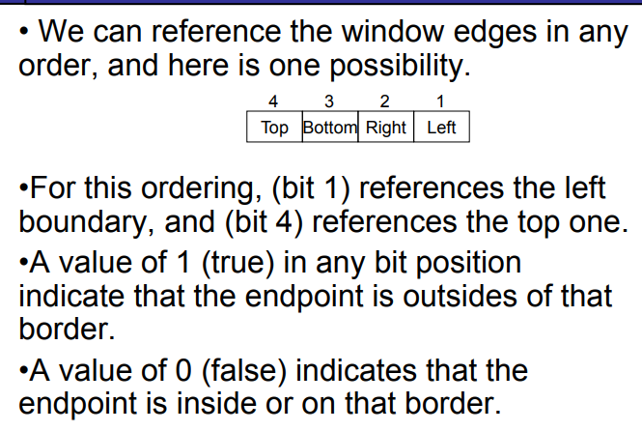

Slide 21
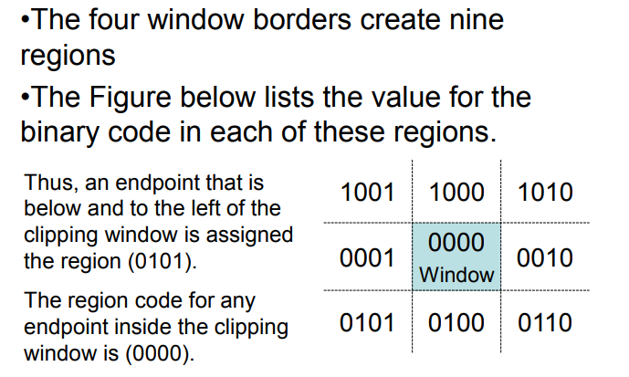
Remember TBRL

Slide 22
example

Slide 23
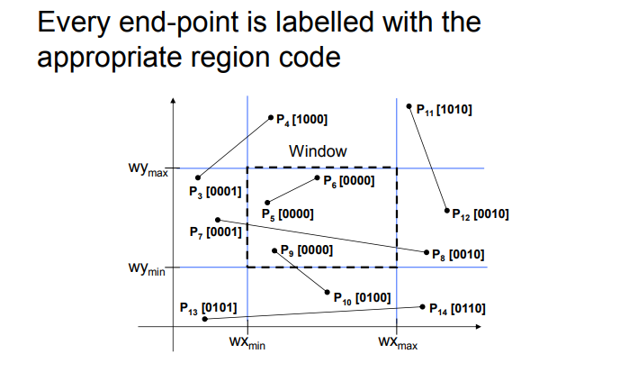

Slide 24
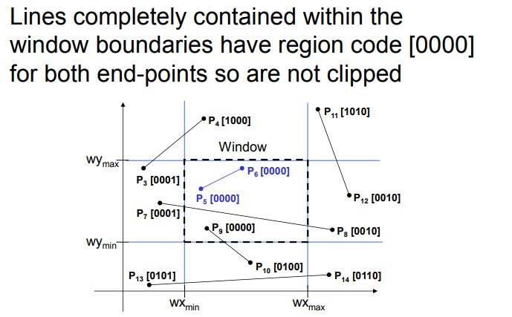

Slide 25
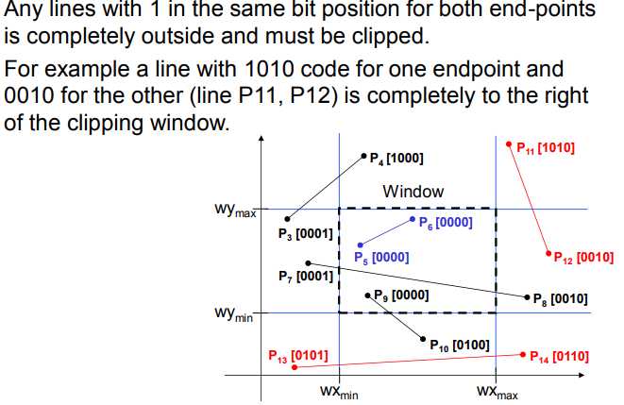

Slide 26
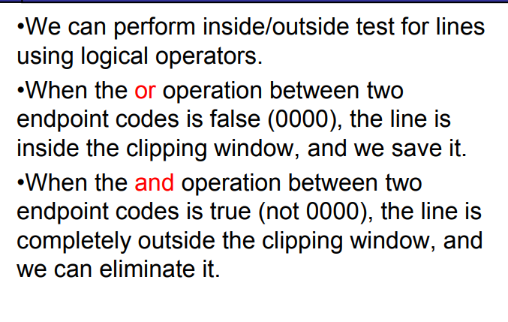

Slide 27
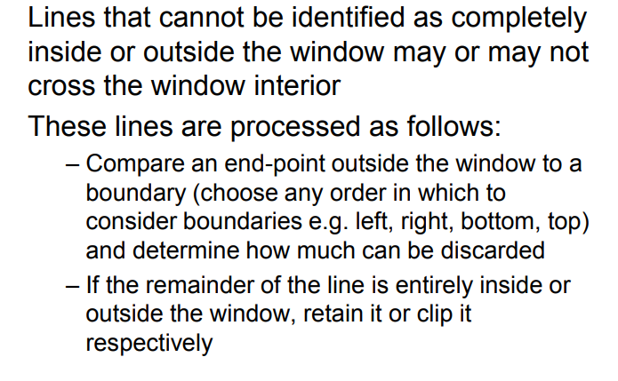

Slide 28
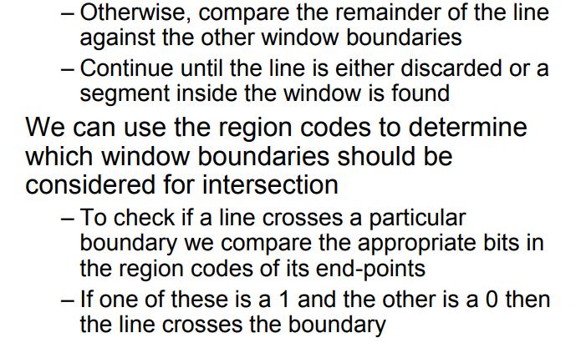

Slide 29
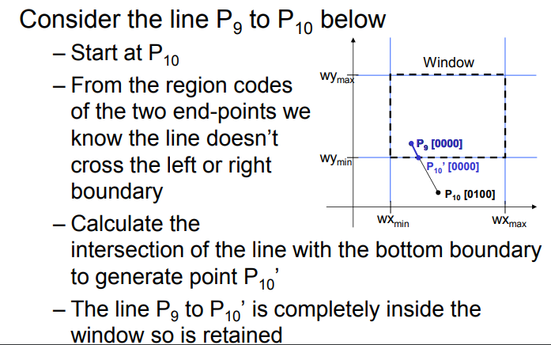

Slide 30
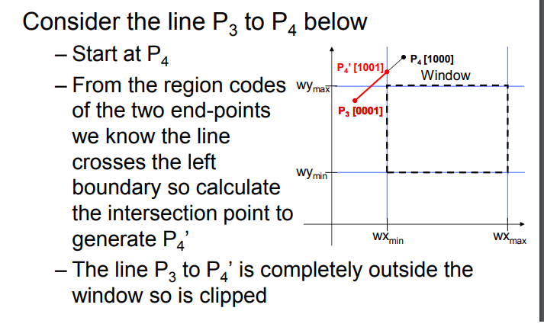

Slide 31
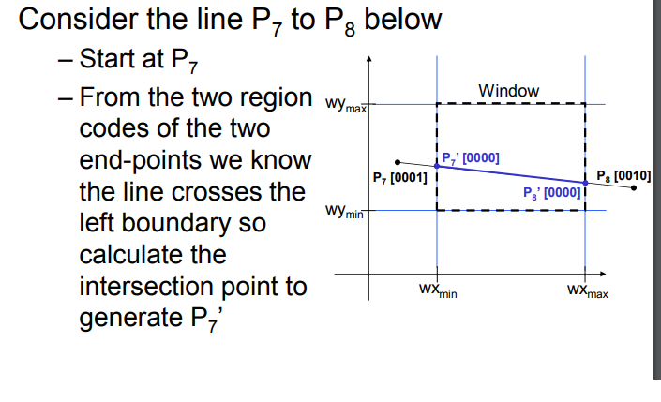

Slide 32
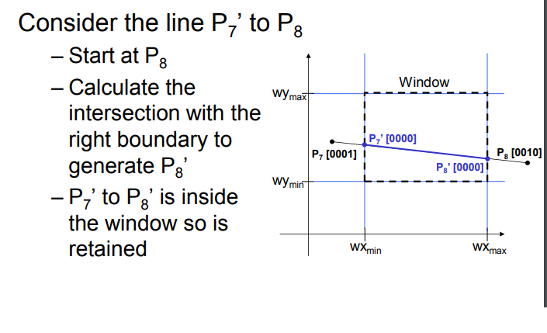

Slide 33
assignment

Slide 34
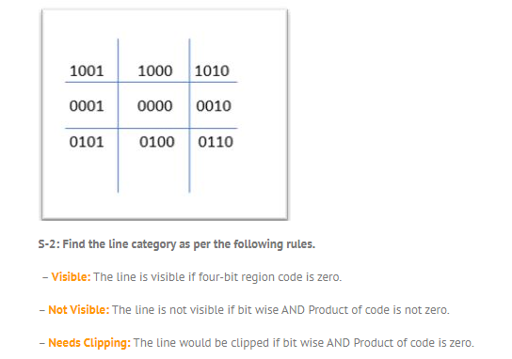

Slide 35
